Slide 1

Really cool movie title
Brianna Beyer
Joshua Moe
Grant Samson
Tim barney

Slide 2

Project Scope
What makes a movie successful?
Genre analysis: What’s the most popular movie genre?
Box Office analysis: What are the movie trends based on box office numbers?
Movie Rating analysis: What the highest/lowest rated movies for both Metacritic and IMDb?
Runtime/Year analysis: What is the correlation between runtime and the release year?

Slide 3

Project Scope
Randomized list of a 1000 movies (CodeBeautify.org)
OMDB API used to pull movie data

Slide 4

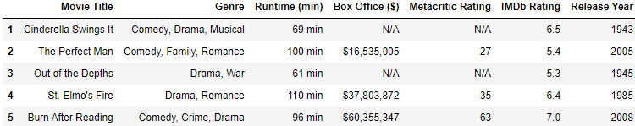
Data Exploration & Cleanup
Created main data frame with the following variables:
Movie Title, Genre, Runtime, Box Office ($), Metacritic Rating, IMDb Rating, and Release Year.

Slide 5
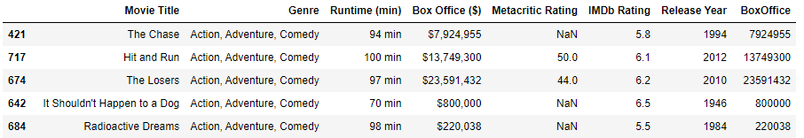
Genre Analysis
Additional data filtering needed to be done for my analyses; resulting in having to drop rows that have null values in either the 'Movie Title' or ' Box Office ($)'--going from 1000 records down to 326 records.

Slide 6

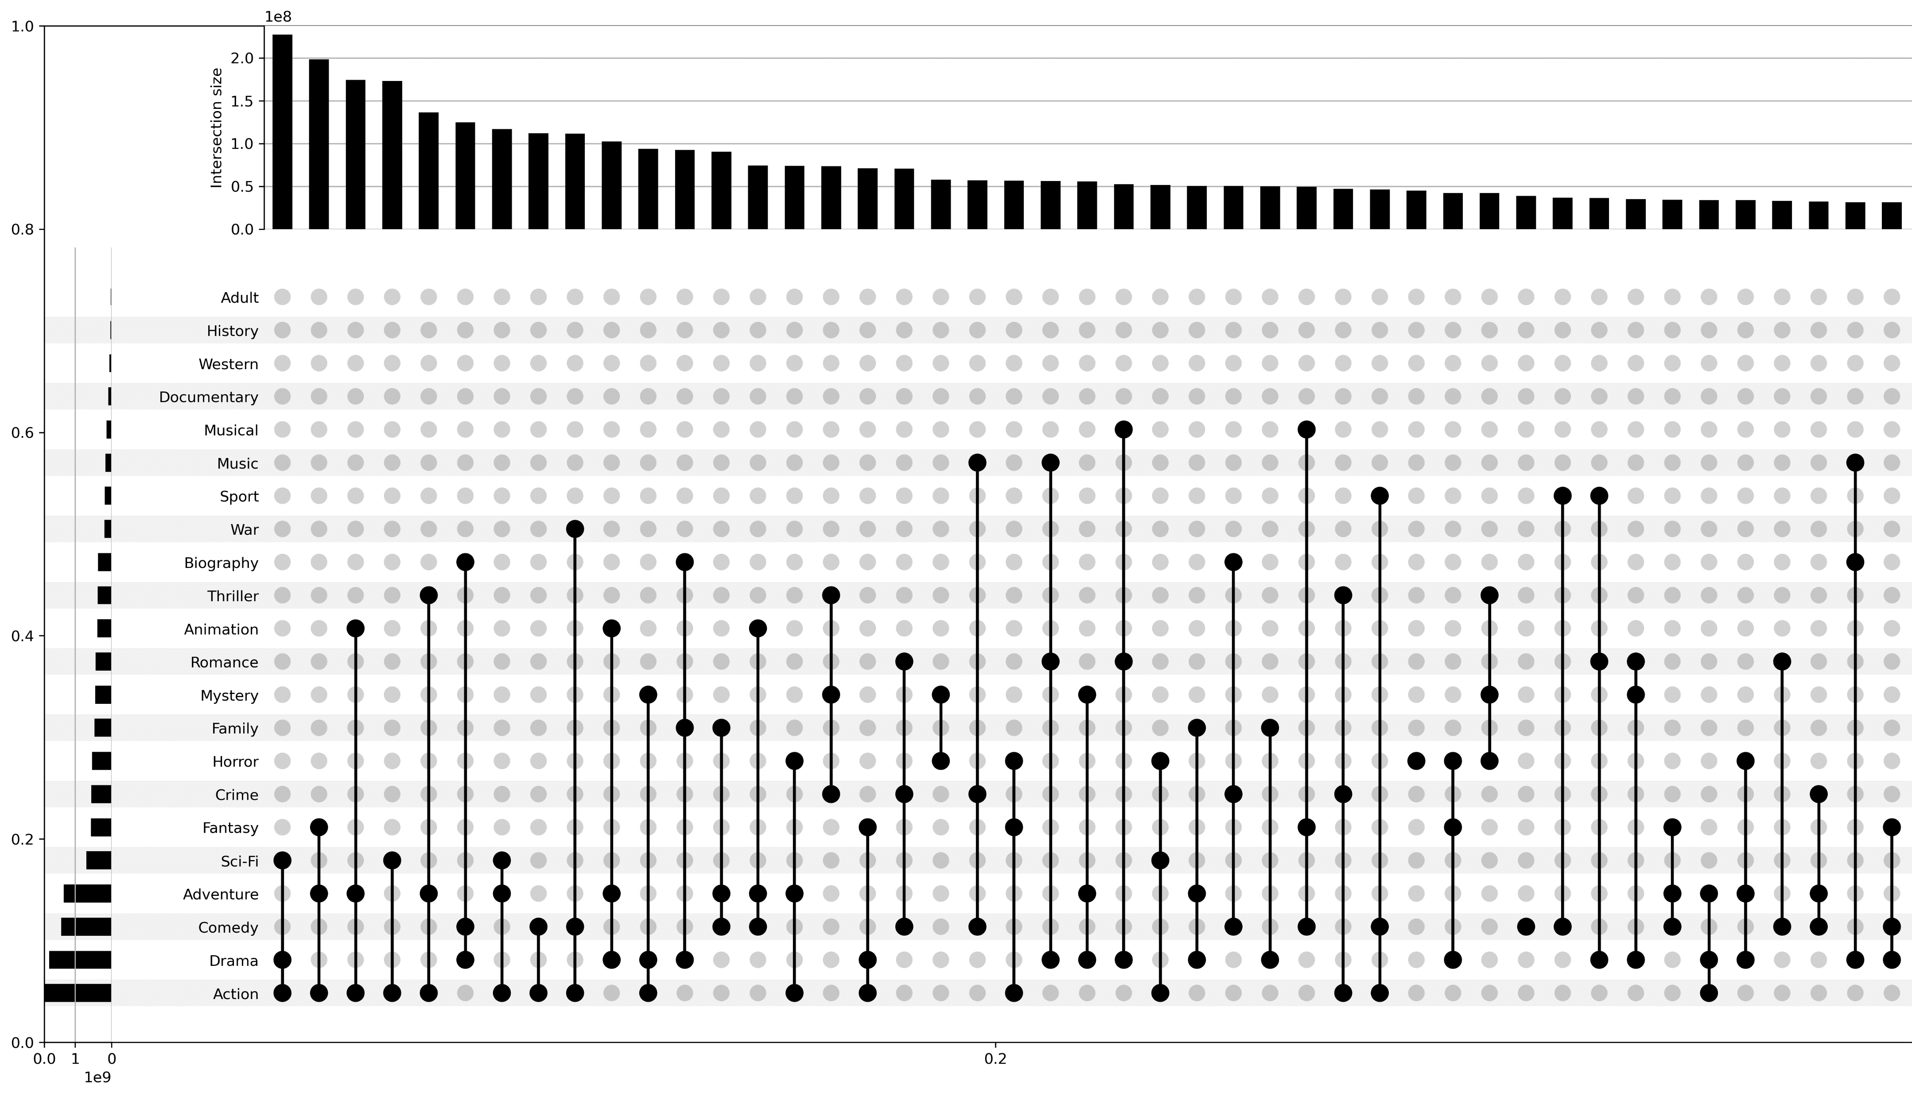
Genre Analysis
The resulting upset plot shows us that the top performing movies tended include the 'Action' and/or 'Adventure' genres. In particular, the 'Action' genre was in included in 8 of the top 10 Genre combinations.

Slide 7
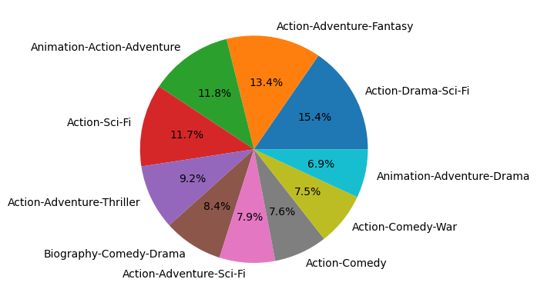

Genre Analysis
The resulting pie chart shows that the non-Action based movies only make up a share of 15.3% of Box Office revenue for the Top 10 movie genre combinations.

Slide 8

Box Office Analysis
Additional data cleaning had to be done. Any rows without a Box Office number was removed.
The highest grossing movie is Star Wars: Episode III - Revenge of the Sith making about $380 million, which is about $100 million above the second highest movie.
The lowest grossing movie is Trojan War making about $309.
There are a variety of reasons that these movies could have succeeded or failed, such as different movie studios, different directors, who the actors are, or the year they were released.

Slide 9
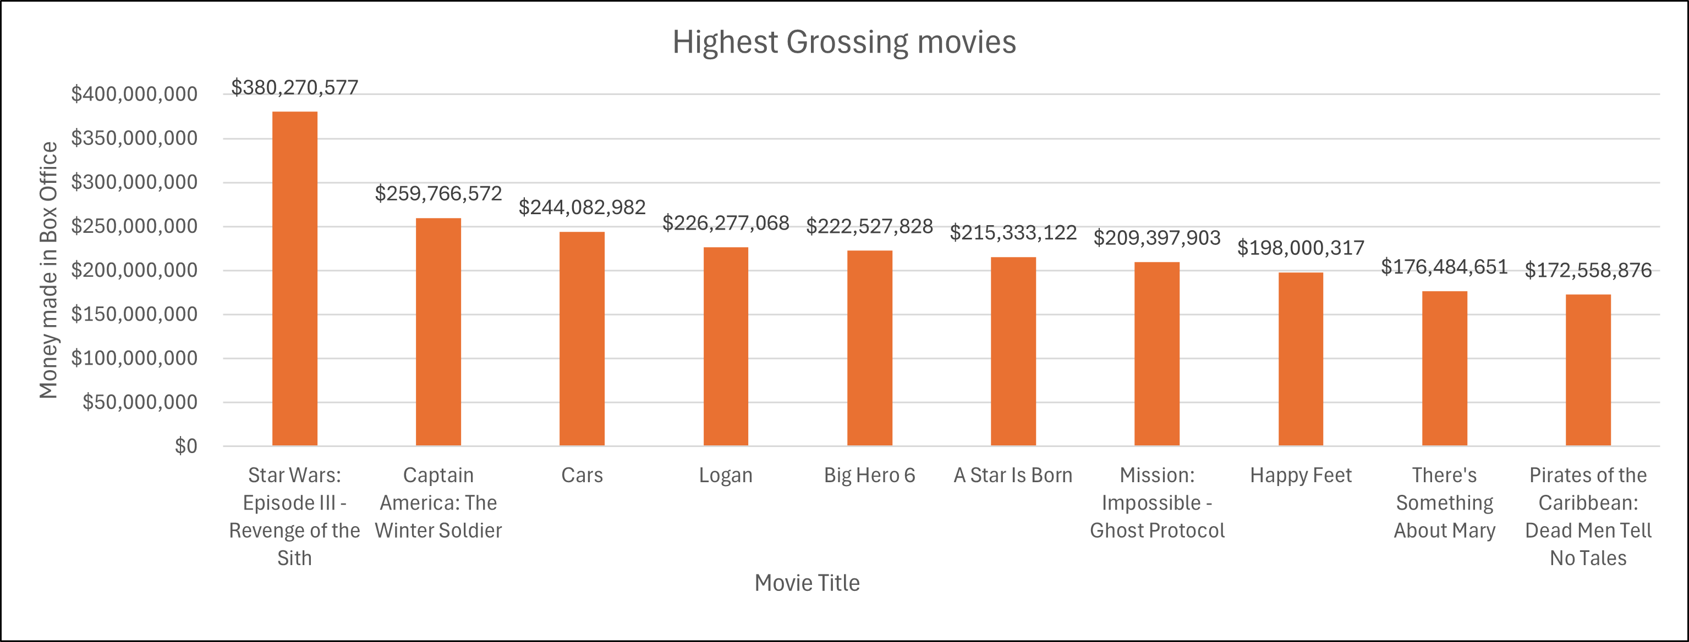
Box Office Analysis

Slide 10
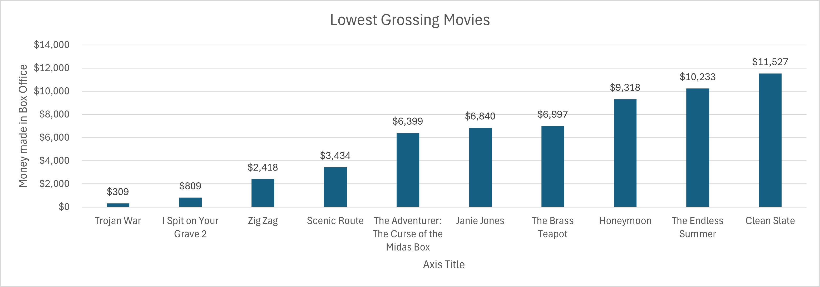
Box Office Analysis

Slide 11

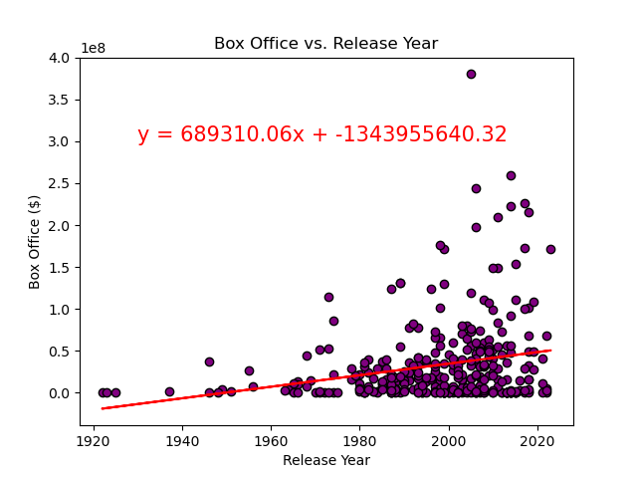
Box Office Analysis
The correlation coefficient between these two variables is 0.24, which is a very weak correlation.
If you look at the scatter plot, you can see that there are more movies in our data set that were released after about 1980. There are also more movies that have a higher box office numbers.

Slide 12

Rating Analysis: Metacritic vs. IMDb
Meta vs IMDb
IMDb is mainly used to see what the general audience think about movies. It is used to see what other people think about movies.
Metacritic on the other hand collects other revies and using their own algorithm and equation to consolidate them into an overall score. Metacritic can make it easy to compare professional and user reviews next to each other.
Looking at the bar graphs, you’ll see that none of the comparisons between Meta and IMDb overlap.

Slide 13
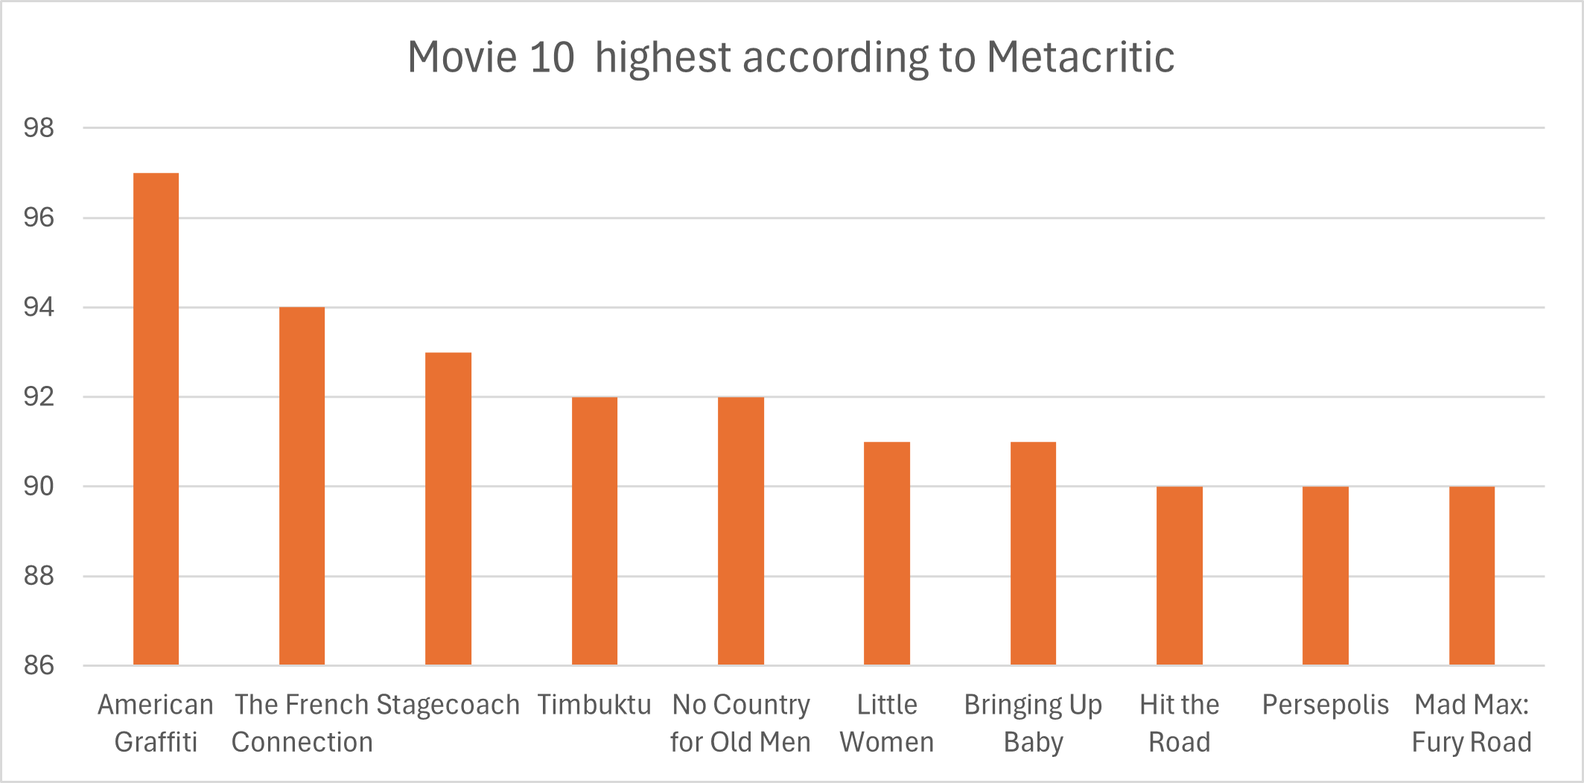
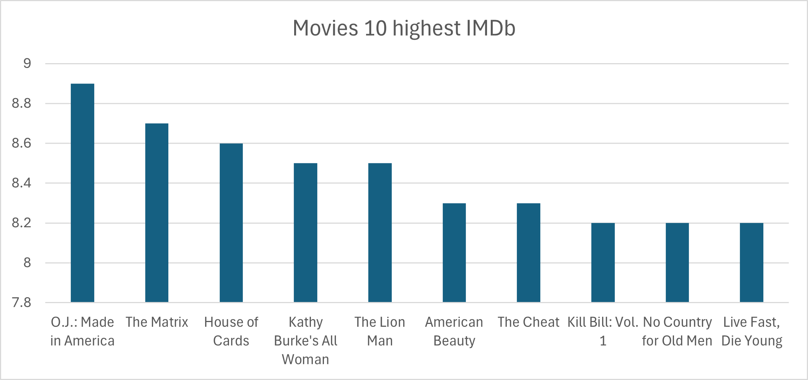
Rating Analysis: Metacritic vs. IMDb
Highest Metacritic rated movie is “American Graffiti”, and the highest IMDb rated movie is “O.J.: Made in America”.

Slide 14
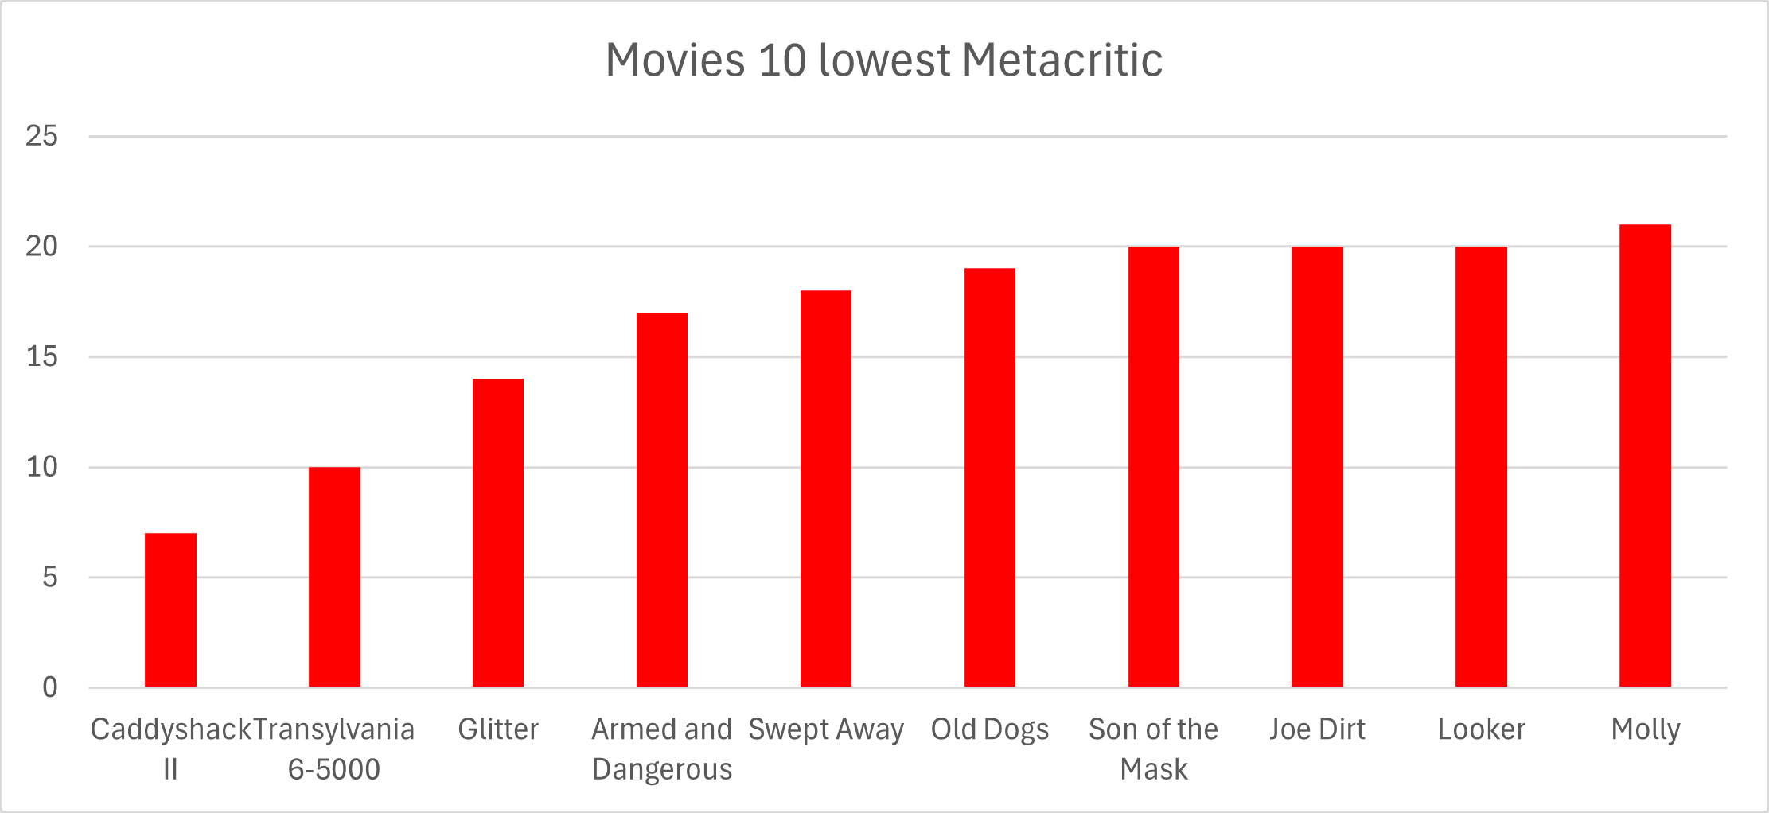
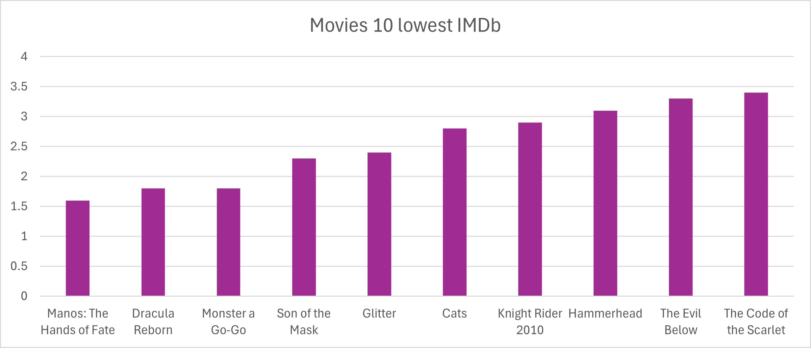
Rating Analysis: Metacritic vs. IMDb
The lowest Metacritic rated movie is “Caddyshack II”, and the lowest IMDb rated movie is “Manos: The Hands of Fate”.

Slide 15

Runtime/Year Analysis
Beginning from the early 20th century to the present day, there is a large increase in the average runtime of movies. This trend suggests a shift in filmmaking practices, possibly influenced by changes in audience preferences, storytelling techniques, or advancements in technology allowing for more extensive narratives. Additionally, while there are changes and outliers in movie runtimes across different decades, the overall trajectory points towards a steady increase, indicating a significant evolution in the duration of cinematic experiences over the last century.

Slide 16
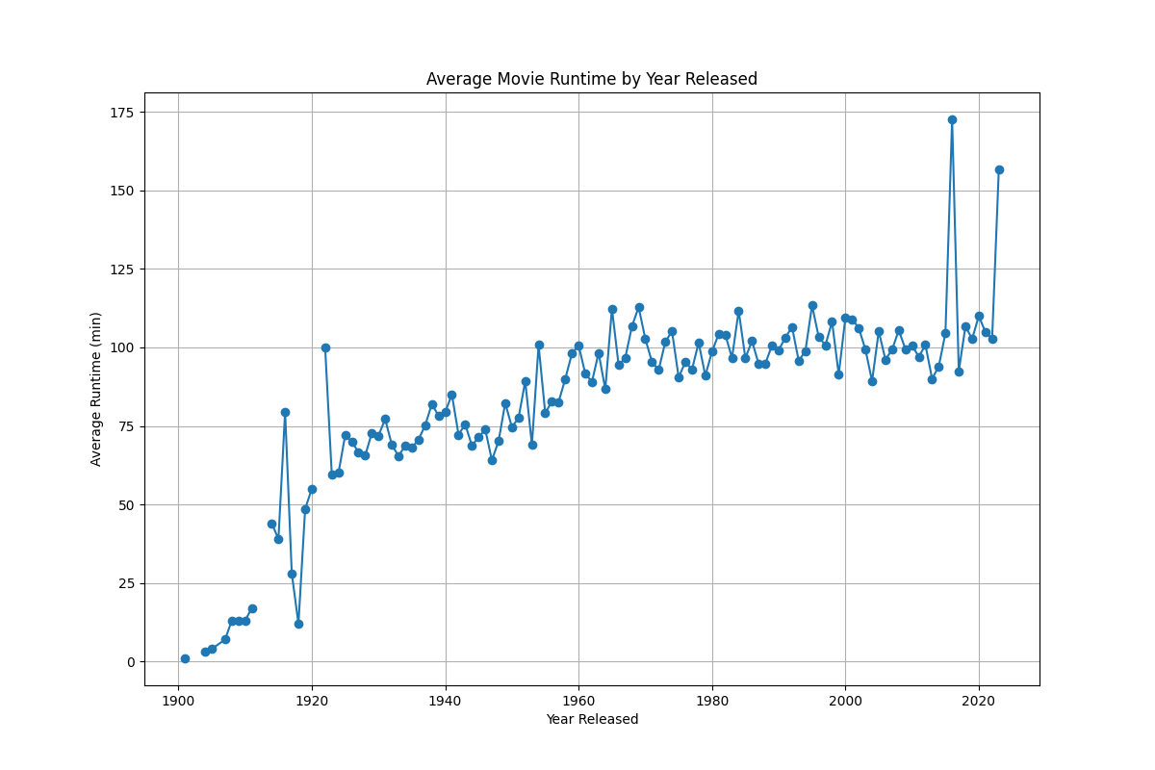

Runtime/Year Analysis
Looking at the average runtime of movies released over the past century, we can see a significant upward trend. This suggests that, on average, movies have indeed become longer over time.

Slide 17
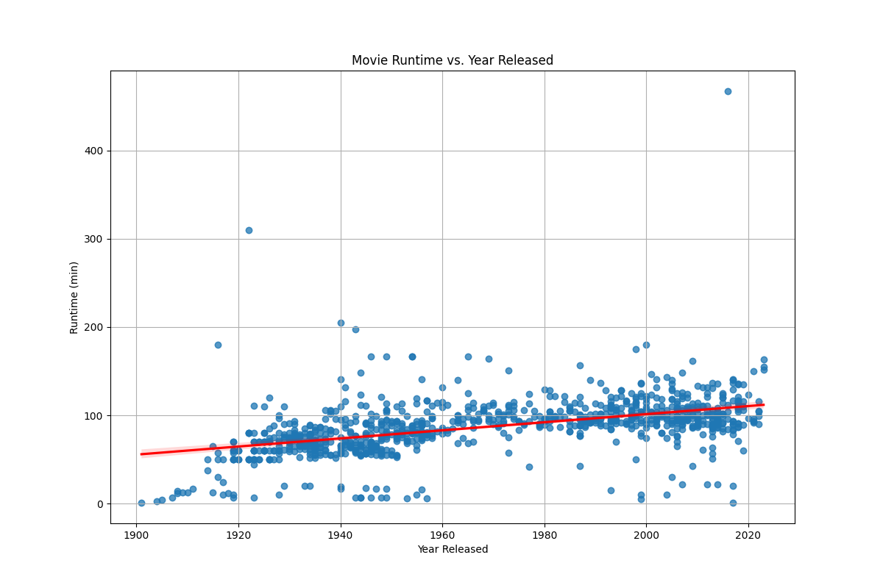

Runtime/Year Analysis
The correlation between both factors is 0.49, which is a weak to moderate correlation.
Along with a line of best fit, trends such as the overall increase in movie runtimes over time can be observed, along with any outliers or clusters of data points.

Slide 18

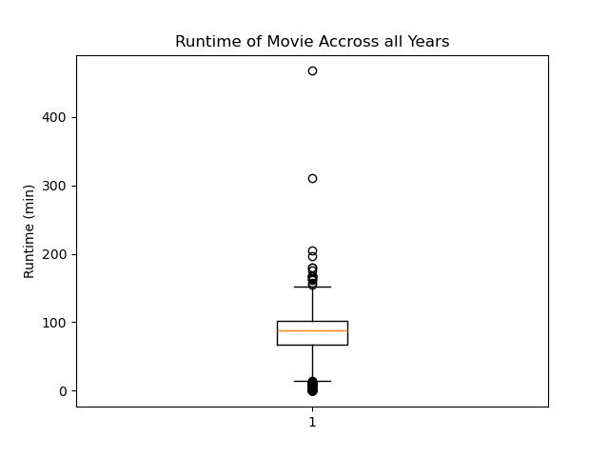
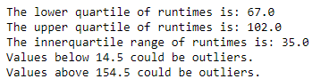
Runtime/Year Analysis
Based on the 1000 movies chosen, outliers are defined as films with durations below 14.5 minutes or above 154.5 minutes. These extreme values, while potentially reflecting unique artistic expressions or commercial strategies, should be interpreted cautiously to ensure an accurate understanding of movie runtime trends across different release years.

Slide 19

Summary of Analysis
The upset plot shows us that our top performing movie genres included Action and/or Adventure.
The scatter plot with box office vs. year shows a very weak correlation.
If you compare Metacritic and IMDb ratings, you can see there is not overlap, so it is hard to see what movies are more successful from this information.
There is a week to moderate correlation be the year and runtime showing there is an upward trend of runtime over time.

Slide 20


